Slide 1
Manufacturer of Broadband Microwave & Millimeter Wave Components
Ver.2209

Slide 2
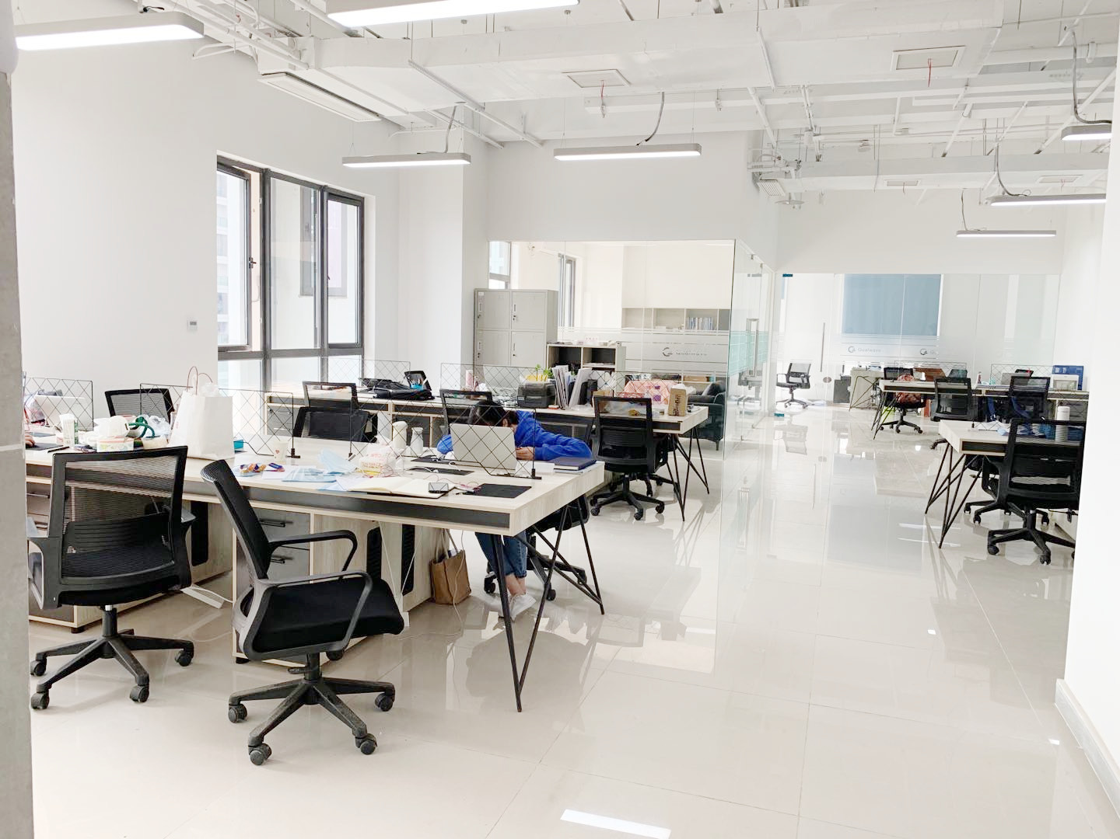
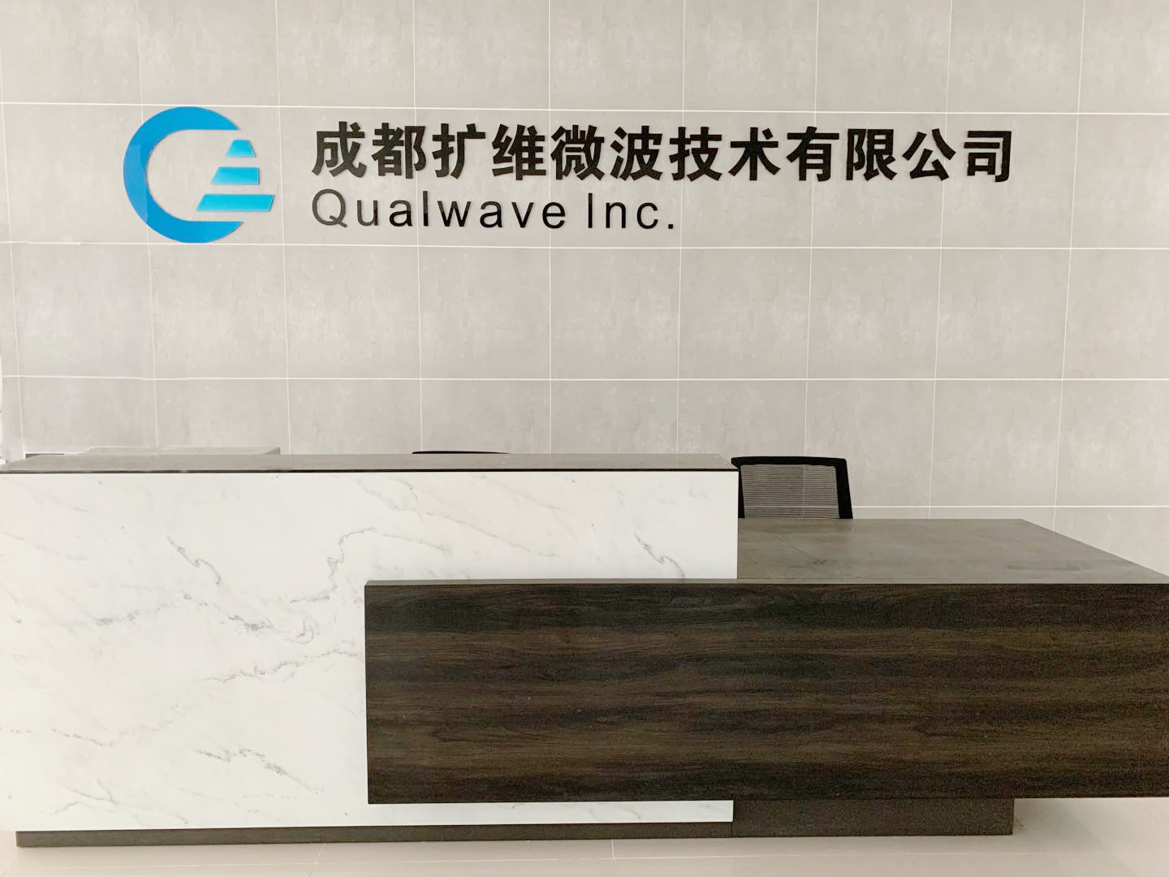
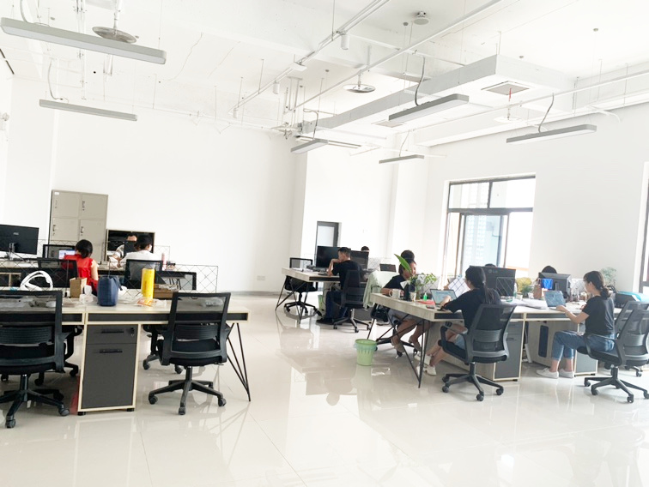
Company Introduction
Qualwave is a privately-owned company based in Chengdu, China. We manufacture both active and passive components in a wide frequency range from DC to 260GHz all over the world. Our products are mainly used in Industry, Defense, Aviatronic, Telecom, Test and Measurement application.

Slide 3
R&D
We have 68 skilled staff, of which there are more than 10 engineers and some of them have more than 14 years’ experience in this industry, 35 well-trained workers.

Slide 4
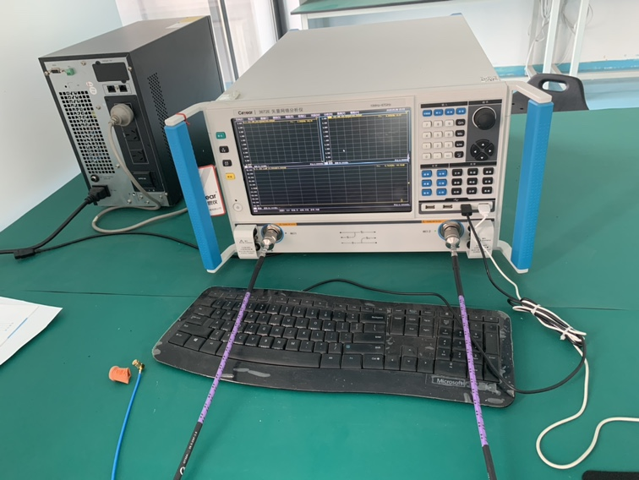
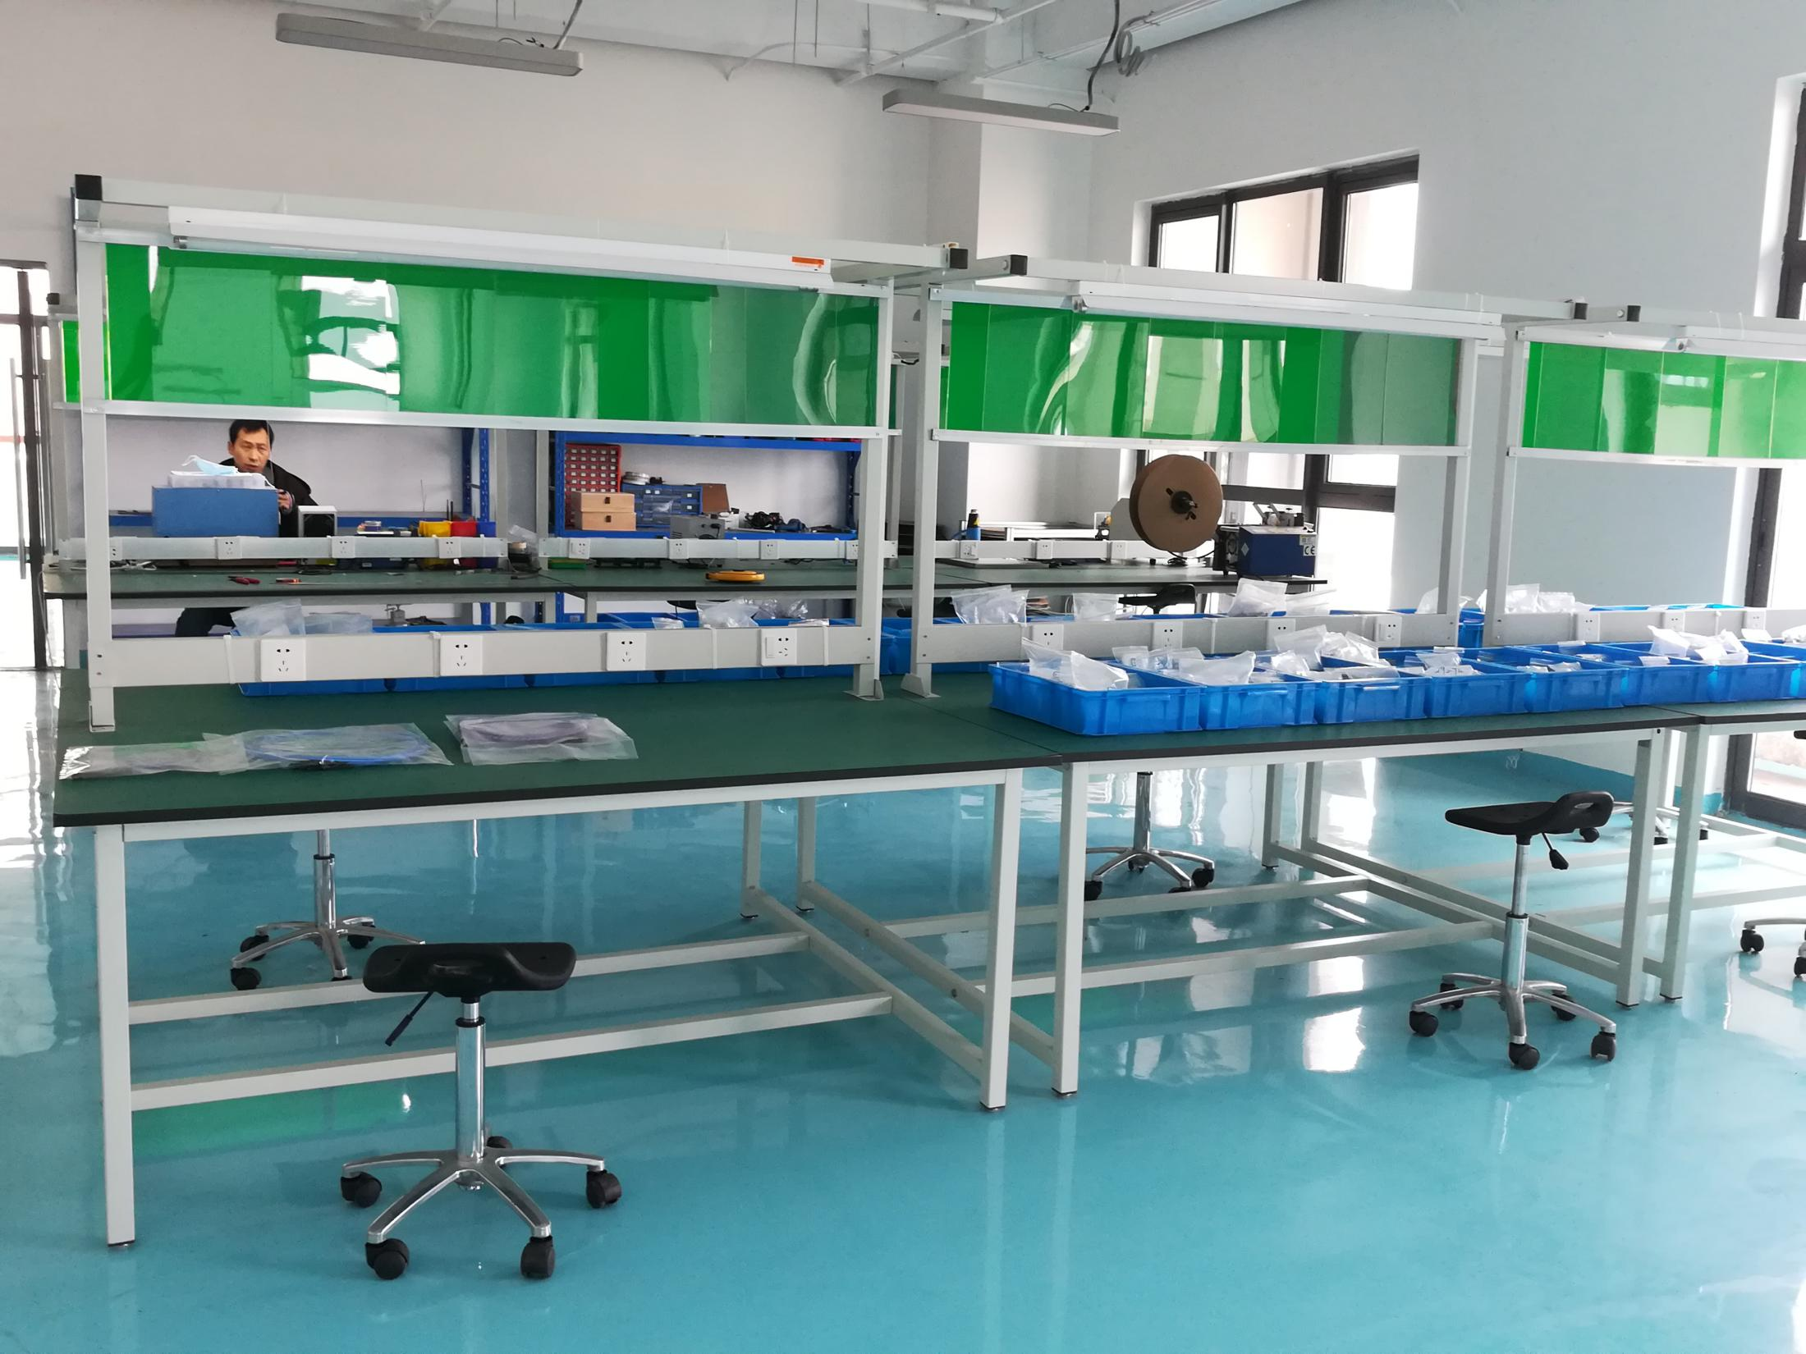
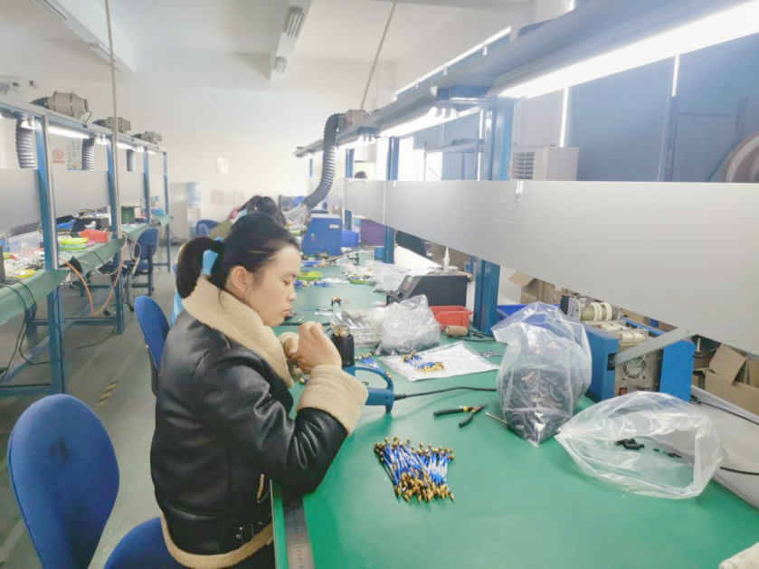
Factory
Our company is equipped with 67GHz vector network analyzers, signal sources, spectrum analyzers, power meters, oscilloscopes, welding platforms, resistance and voltage withstand test instruments, high and low temperature test systems and other research and development, production and testing equipments. Our quality management system has been successfully registered for GB/T19001-2016/ISO9001:2015.

Slide 5
CUSTOMERS

Slide 6
Features
FOCUS
DC~260GHz Microwave & MM-wave Components
Design & Manufacture Active / Passive Components
CAPABILITY
QUALITY
GB/T 19001-2016/ ISO 9001:2015 Certificate
ADVANTAGE
Fast Delivery (0~4weeks) & Competitive Price
SERVICE
Customization + Fast Response

Slide 7
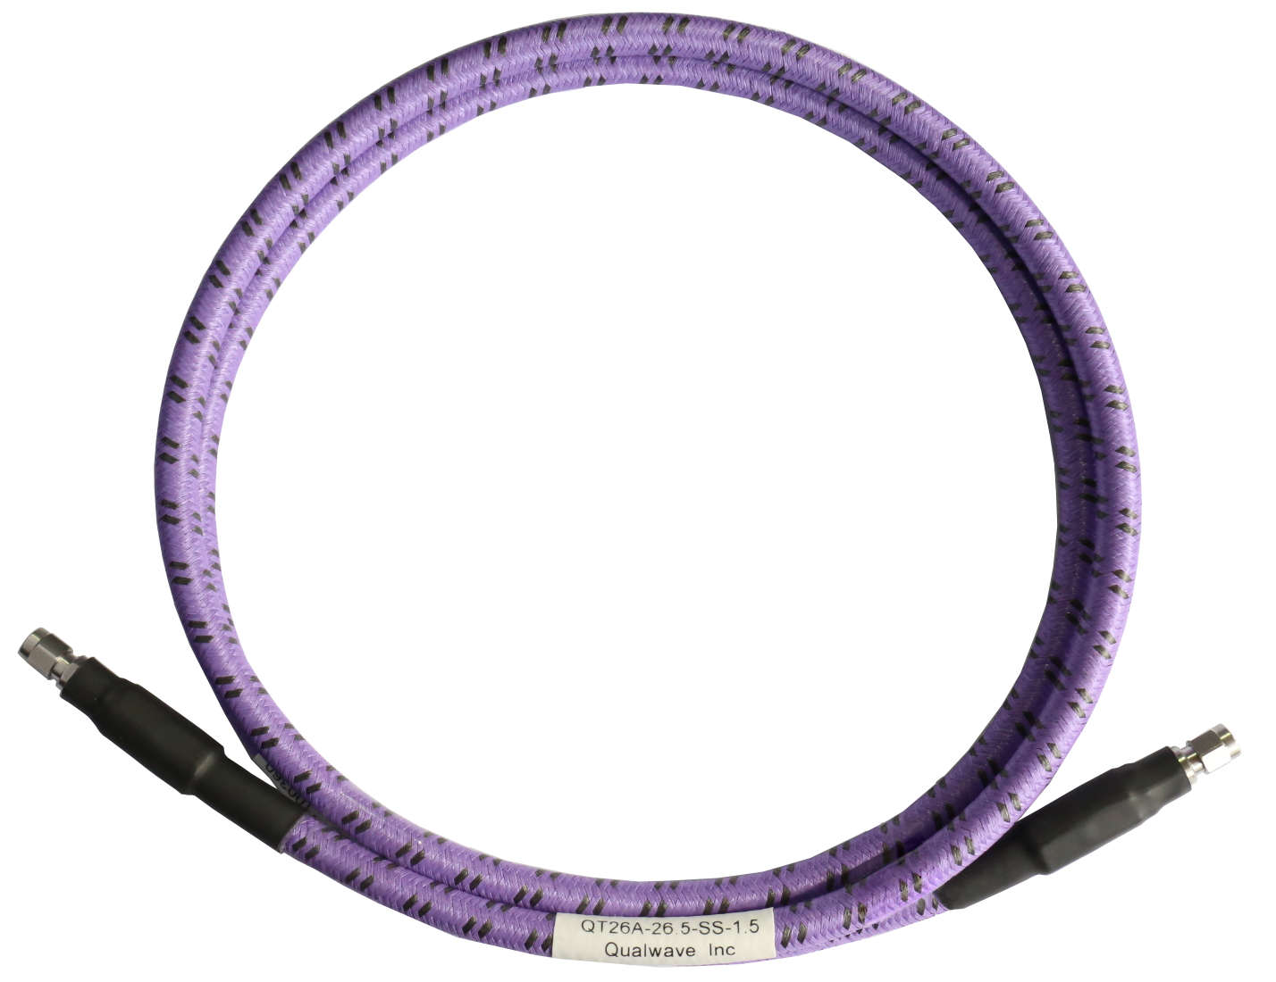
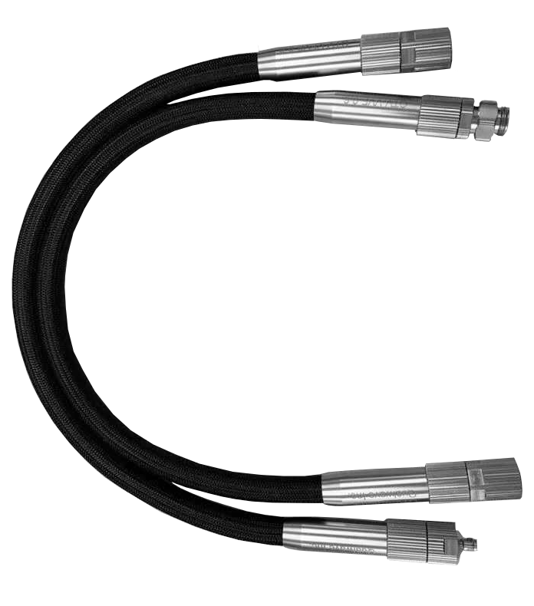
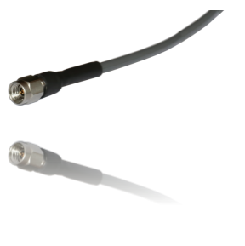
1. Cables & Assemblies
QT Series
QTV Series
QA Series
Test Cable QT Series
Up to 110GHz
Long Bending Life
Phase & Loss Stable
Long Flex Life
Up to 67GHz
NMD Connector
Ultra Low Loss
Phase Stable
IL: 2.18dB/m@40GHz

Slide 8
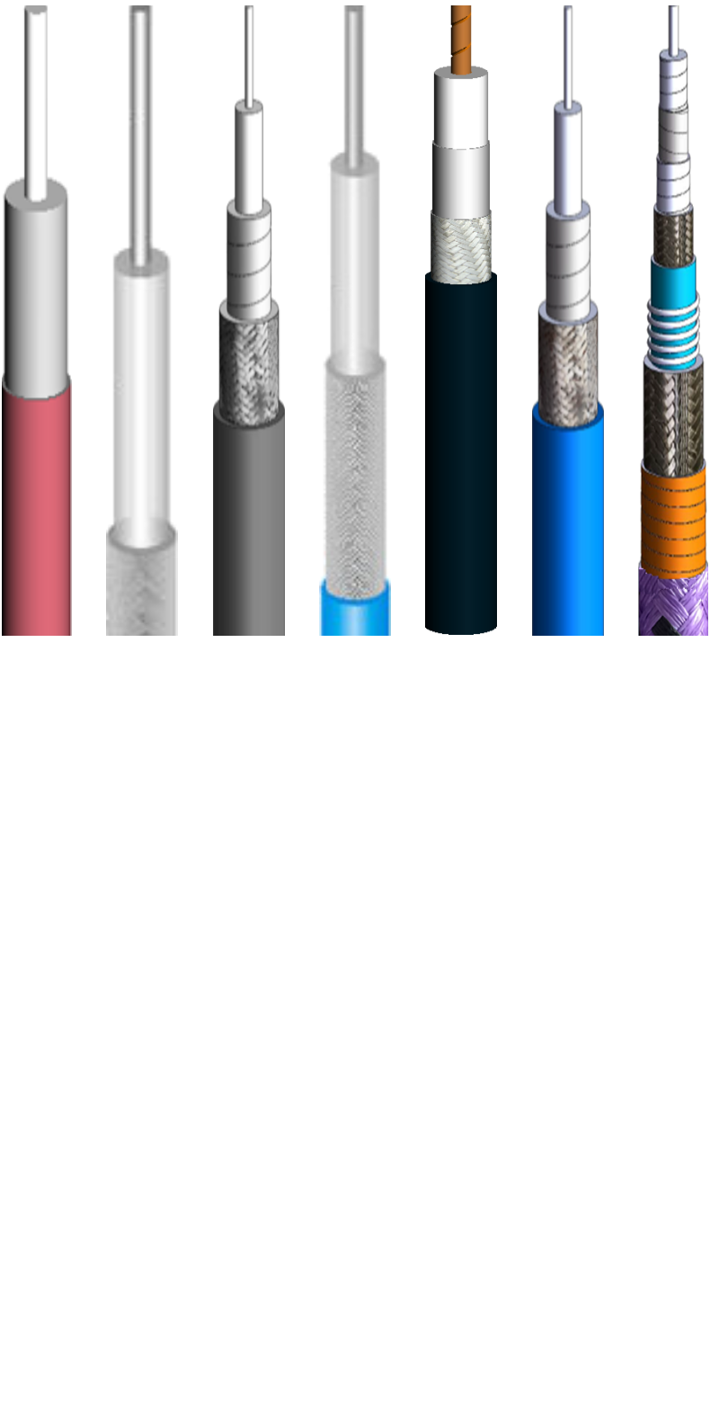
2. Cables & Assemblies
QH Series: Flex. 40GHz, 086/141
QE Series: Semi-Rigid, 40GHz, 086/141
QD Series: Semi-Flex, 40GHz, 086/141
QR Series: Wireless Communication/LMR Cable
RG Series: RG58, RG142, RG174, RG178, RG304, RG316(D), RG400...

Slide 9
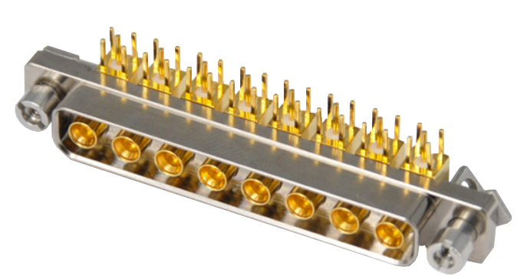
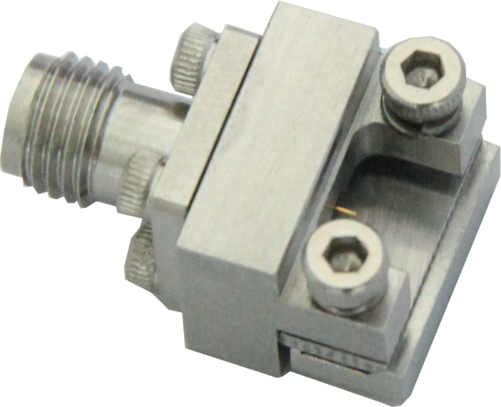
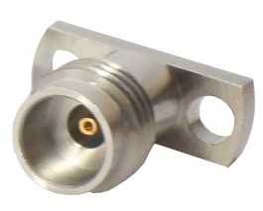
Connectors
PCB Connector
End Launch Connector
Cable Connector
* DC-110GHz | Customization is available
Connectors
Connectors
1.00
mm
1.85
mm
2.4
mm
2.92
mm
3.5
mm
7/16
(DIN)
N
SC
TNC
SSMP
SSMA
SMA
BNC
SMP

Slide 10
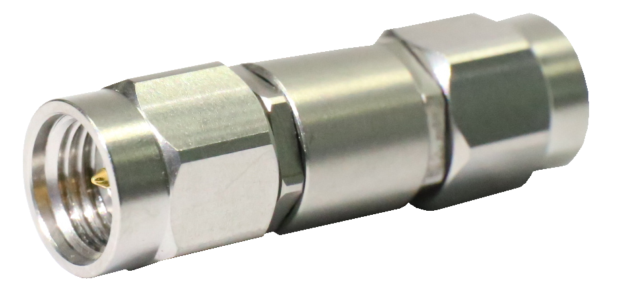
Coaxial Adapters
DC-110GHz
VSWR<1.15@40GHz
Customization is available
QAK3-MM
* NMD adapter is avaible
Connectors
1.00
mm
1.85
mm
2.4
mm
2.92
mm
3.5
mm
7/16
(DIN)
N
SC
TNC
SSMP
SSMA
SMA
BNC
SMP

Slide 11
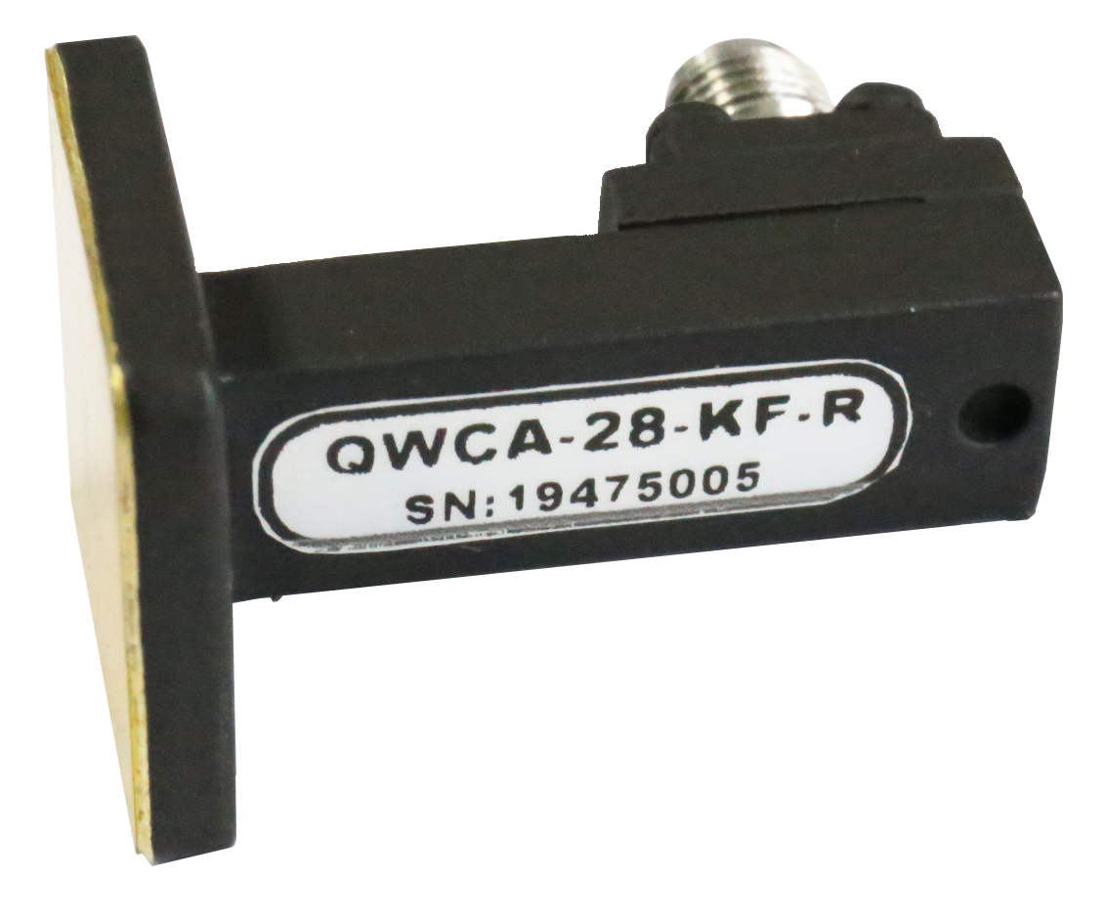
Waveguide to Coax Adapters
DC-110GHz
Double Ridged Waveguide Available
Customization is available
Connectors
1.00
mm
1.85
mm
2.4
mm
2.92
mm
SMA
N
WR10
WR12
WR15
WR19
WR22
WR975
WRD-180
WRD
-84

Slide 12
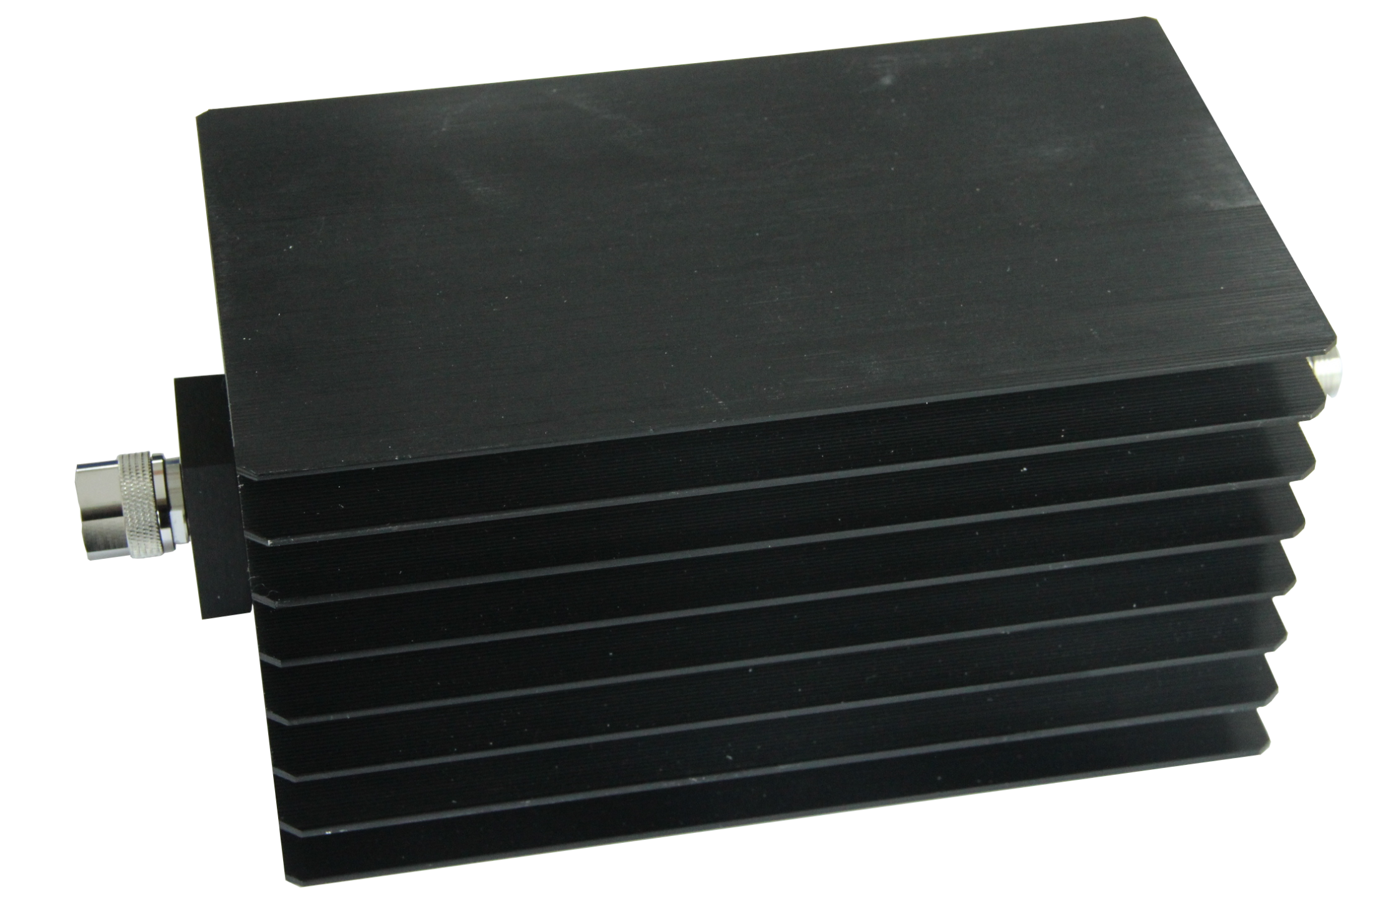
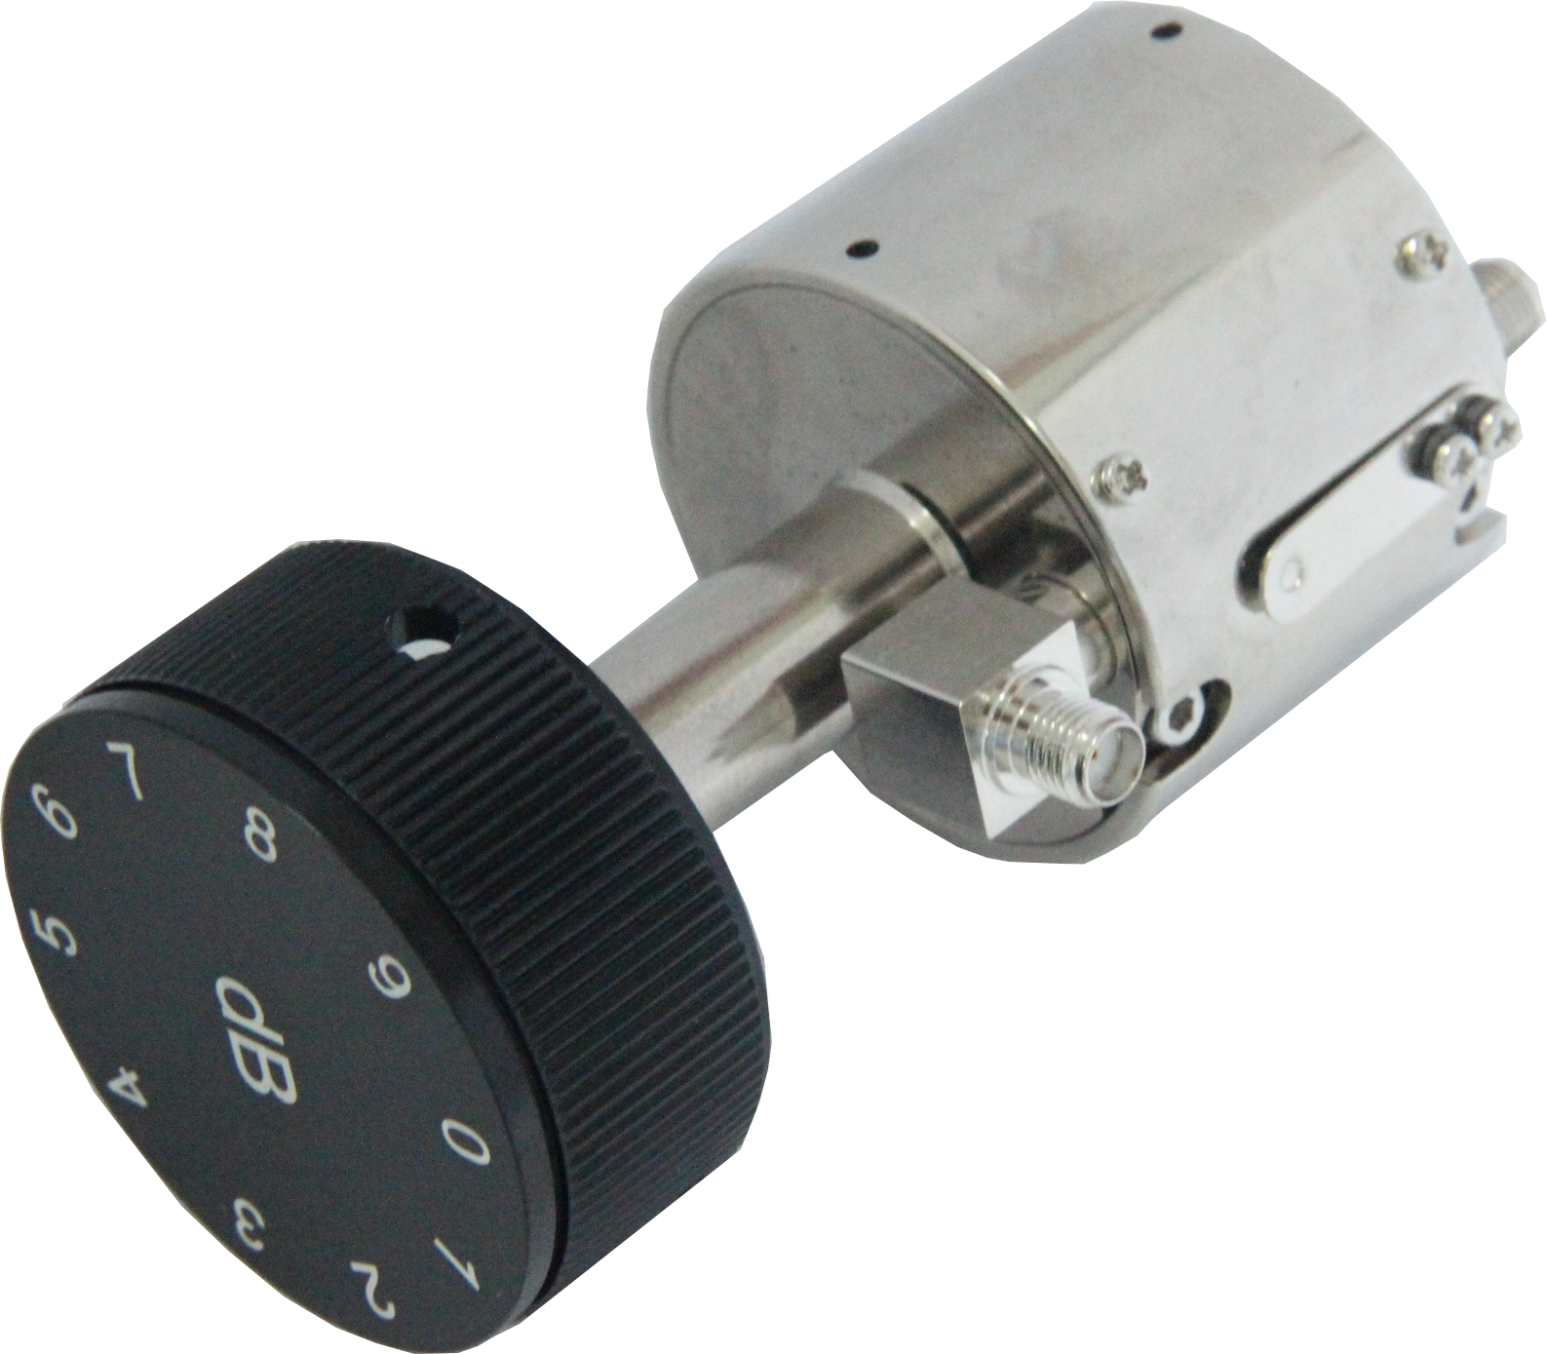
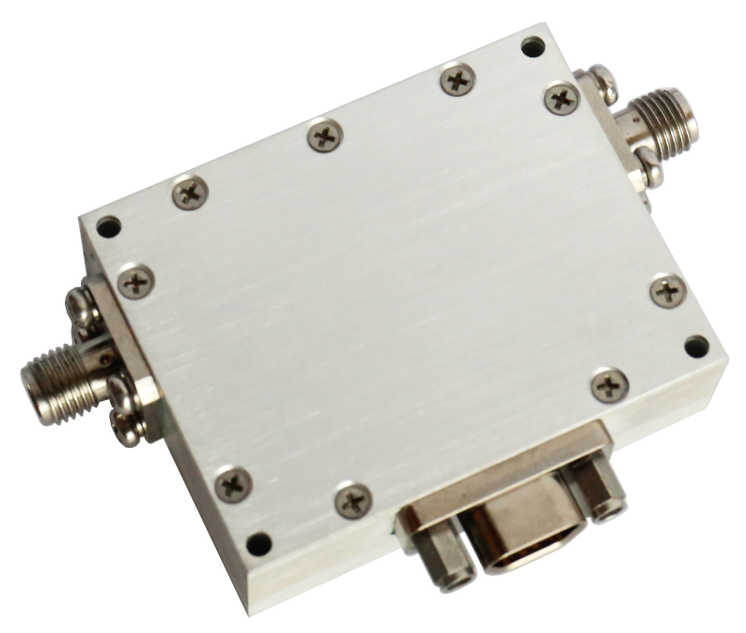
Attenuators
Fixed Attenuators: Up to 110GHz | 600W @18GHz
Rotary Stepped Attenuators: Up to 40GHz | High Accuracy
Continuously Variable Attenuators: DC-18GHz/0-40dB/10W
Digitally controlled Attenuators:
40GHz | 0.25dB Step | Customization Available
Voltage Controlled Attenuators：0.1-40GHz
Attenuators

Slide 13
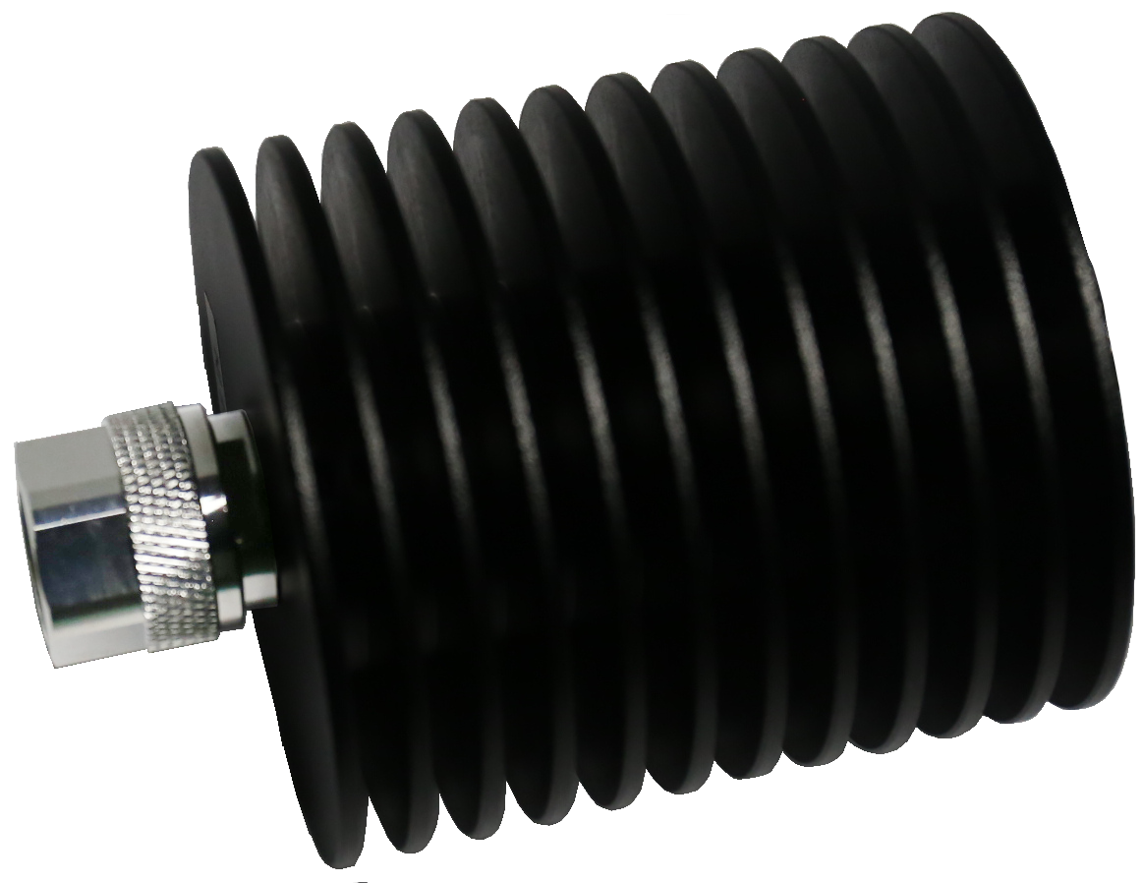
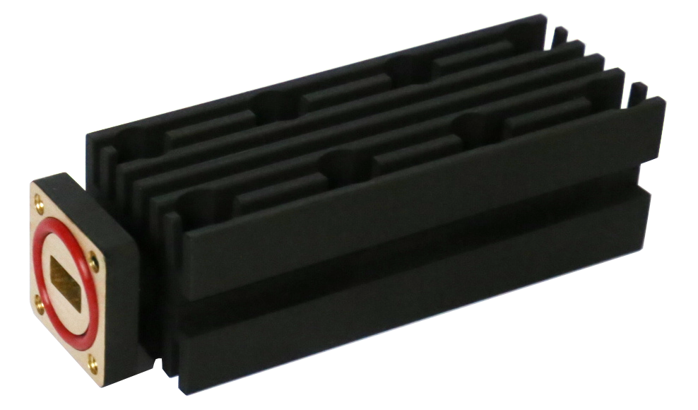
Terminations
Coaxial Terminations:
Up to110GHz | Up to 600W@18GHz
Waveguide Terminations: 1.13~75.8GHz
WR-1150 ~ WR-10 | 5W ~ 2500W
QCT18K1 (18GHz, 100W)
Terminations
QWT3440 (WR34, 40W)

Slide 14
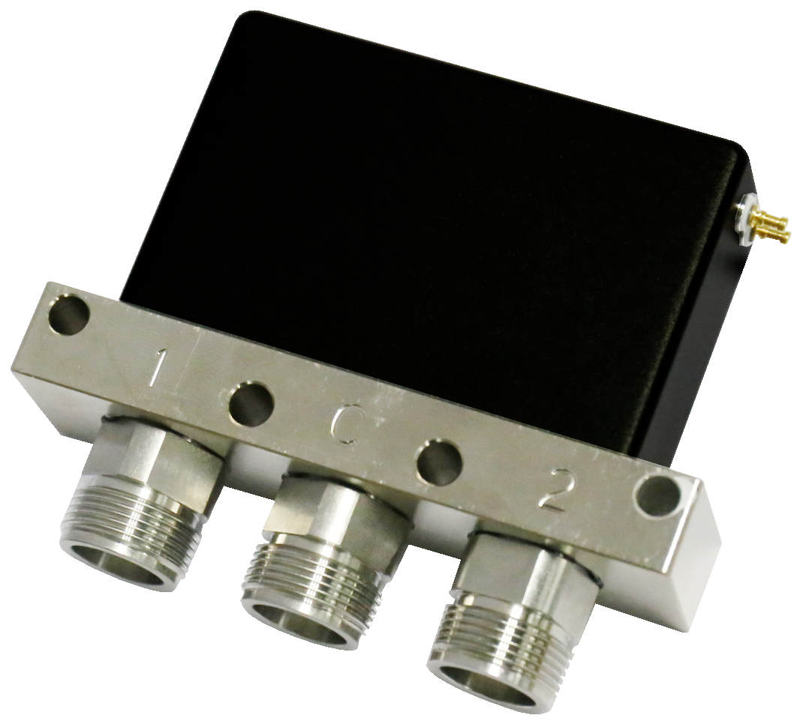
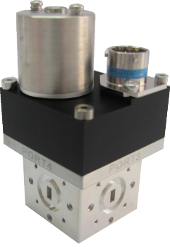
Switches
Pin Diode Switches:
40GHz | 50nS Switching Time | Customization Available
Coaxial Switches:
110GHz | SPDT-SP12T, DPDT, 2P3T | SP8T@40GHz
Extended Temperature: -45~+85 deg.
Waveguide Switches: 3.95~110GHz, WR-187 ~ WR-10
Surface Mount Relay Switches: DC~18GHz, Small Size.
Coaxial Switches

Slide 15
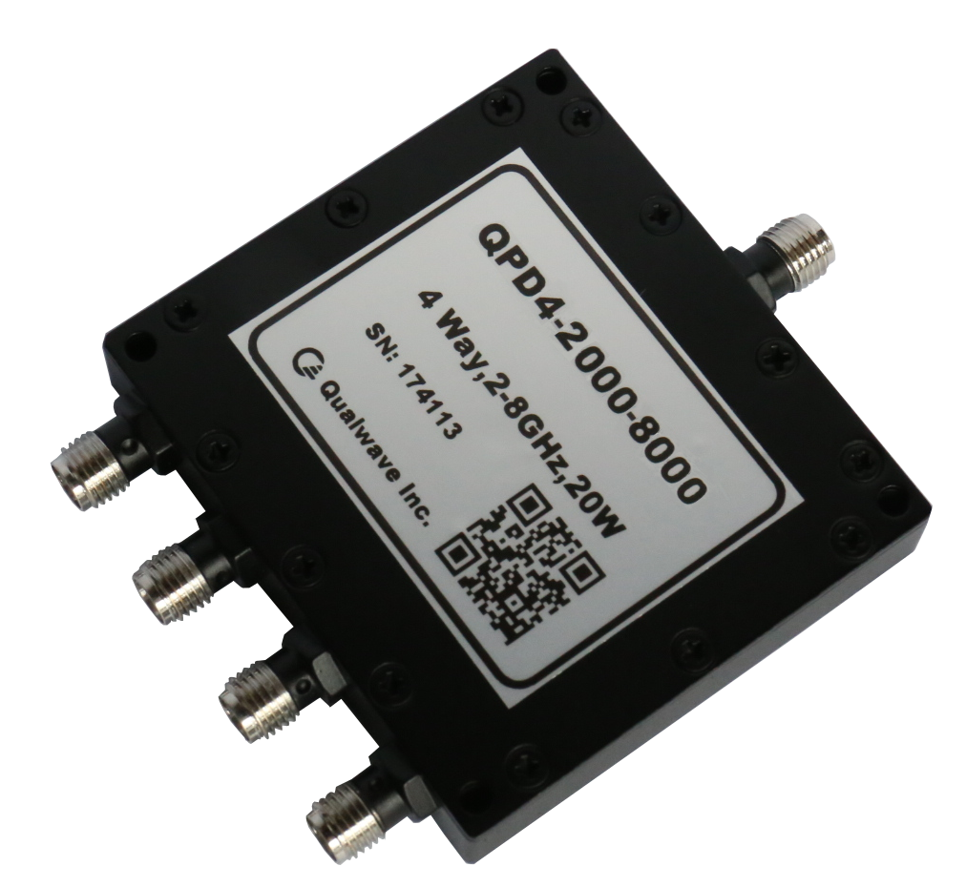
Power Dividers / Combiners
Frequency: DC~110GHz
Path: 2~32 ways
Isolation: 16~25 dB
Power up to 10KW
Amplitude Balance: ±0.2dB~±1dB
Phase Balance: ±2°~±8d°
Power Divider/ Combiner

Slide 16
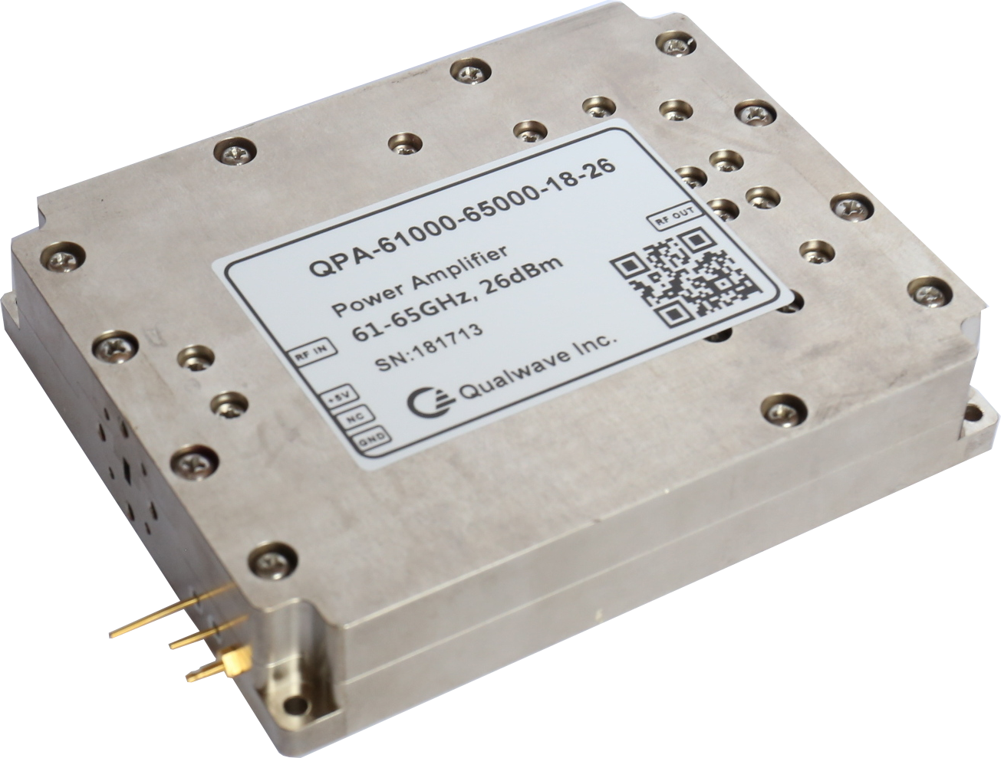
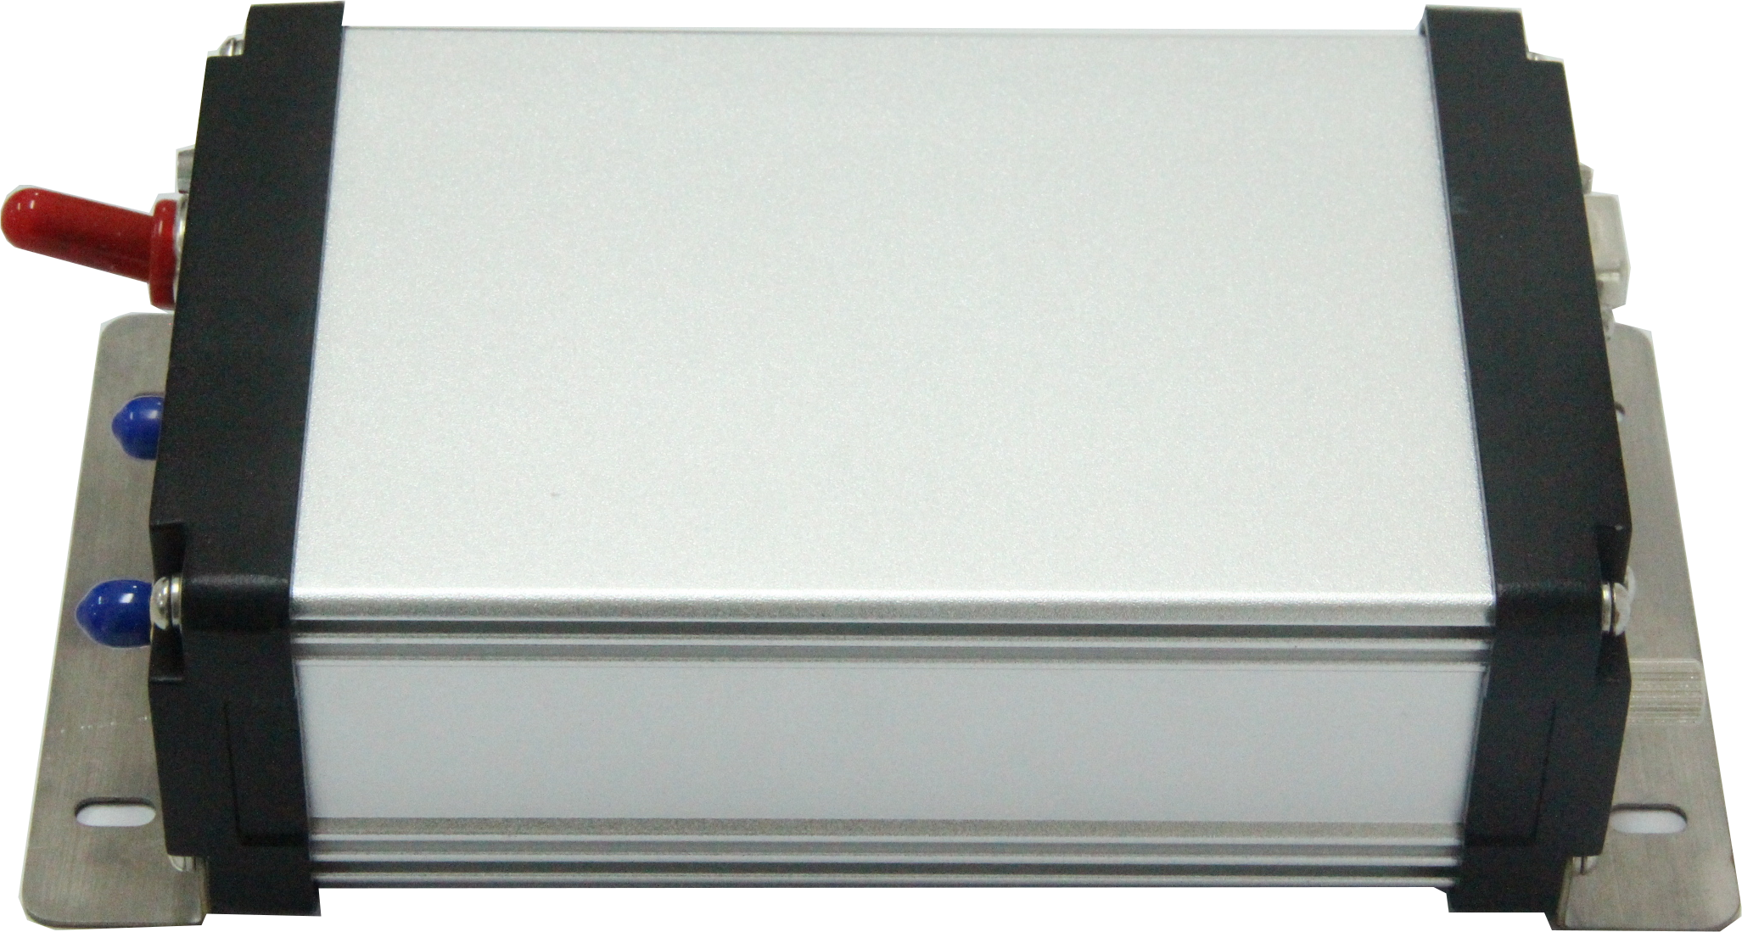
Amplifiers
Freq. 4KHz to 260GHz
Power up to 2000W
Noise figure: down to 0.5dB
Module & System available
PA Module
Power Amplifier & LNA
LNA Bench Top

Slide 17
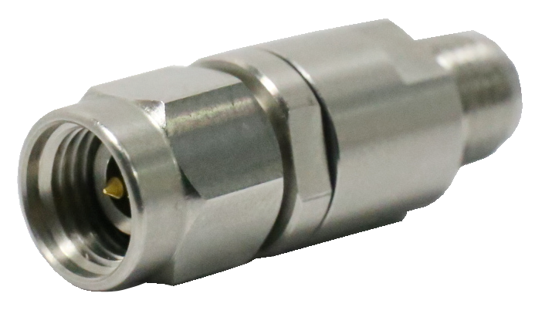
DC-Blocks
Freq. up to 67GHz
Voltage 25V, 50V
IL <0.4dB @ 67GHz
Connectors
1.85
mm
1.85
mm
1.85
mm
2.4
mm
2.4
mm
2.4
mm
2.92
mm
2.92
mm
3.5
mm
3.5
mm
SMA
SMA
N
N

Slide 18
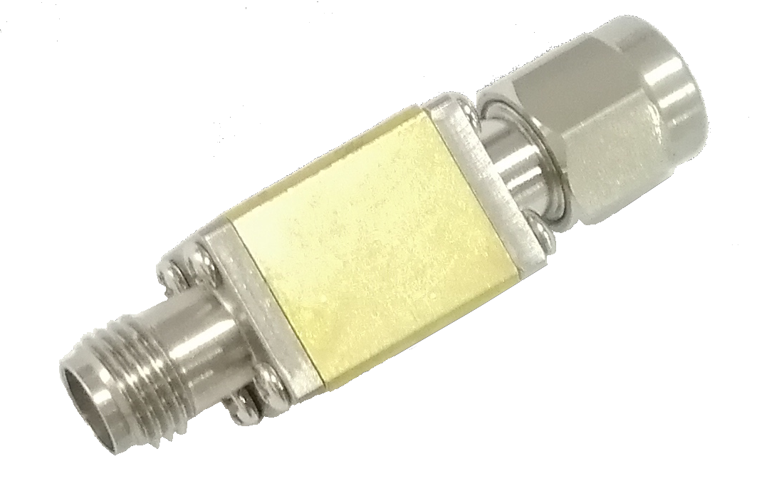
Detectors
Freq. : 10MHz ~ 110GHz
Sensitivity: 100~300 mV/mW
Polarity: Negative / Positive
Input Connector: 2.4mm, SMA, WR28~WR10
Output Connector: 2.92mm, SMA
Detectors
Coaxial Detectors
Waveguide Detectors

Slide 19
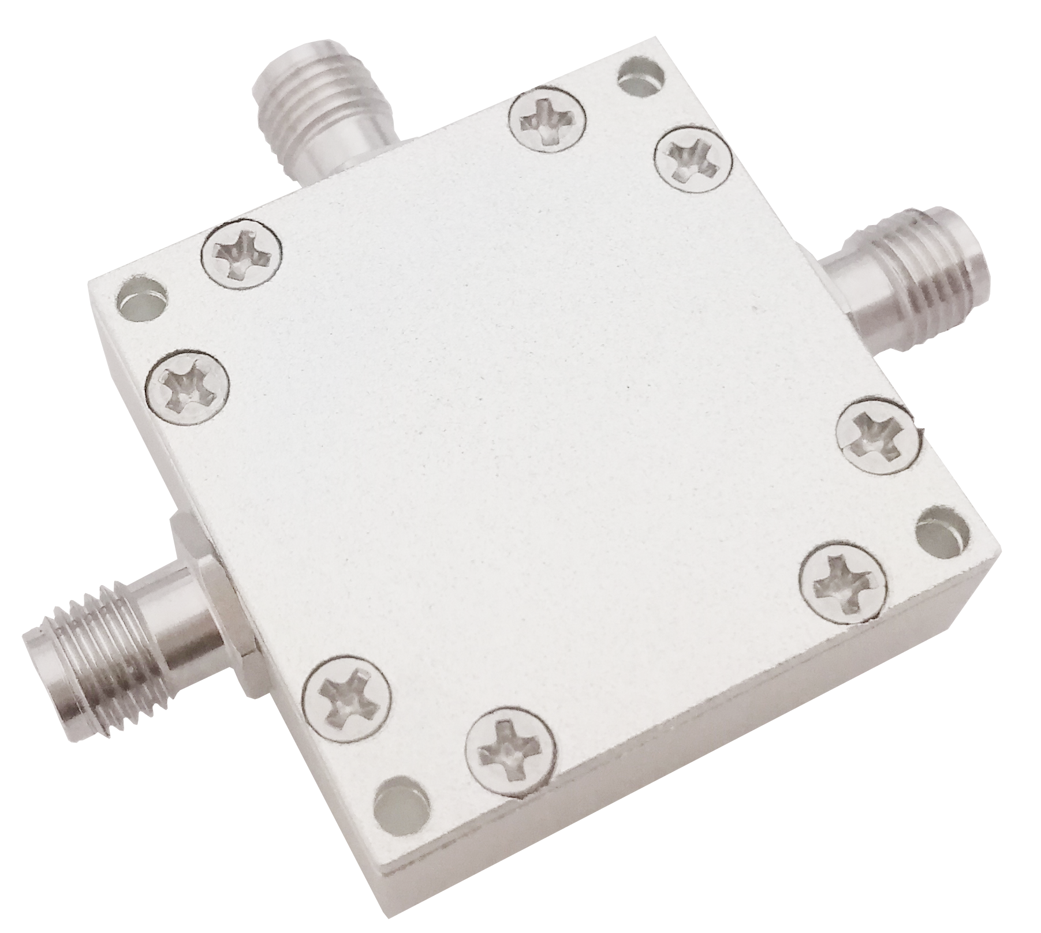
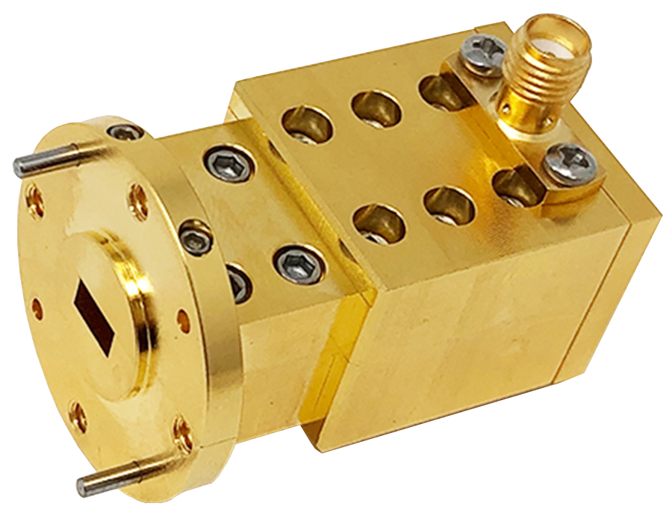
Mixers
Balanced Mixer
Harmonic Mixer
Freq. : 1KHz ~ 110GHz
Mixers
Balanced Mixers
Harmonic
Mixers

Slide 20
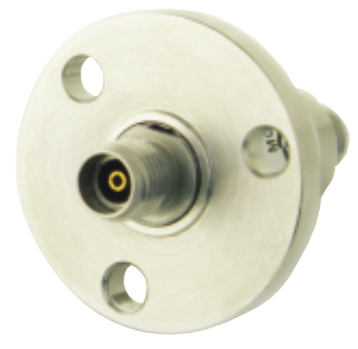
Rotary Joints
Freq. : up to 50GHz
Single Channel & Multi-Channels Available
Electrical Channels Optional
Rotary Joints

Slide 21
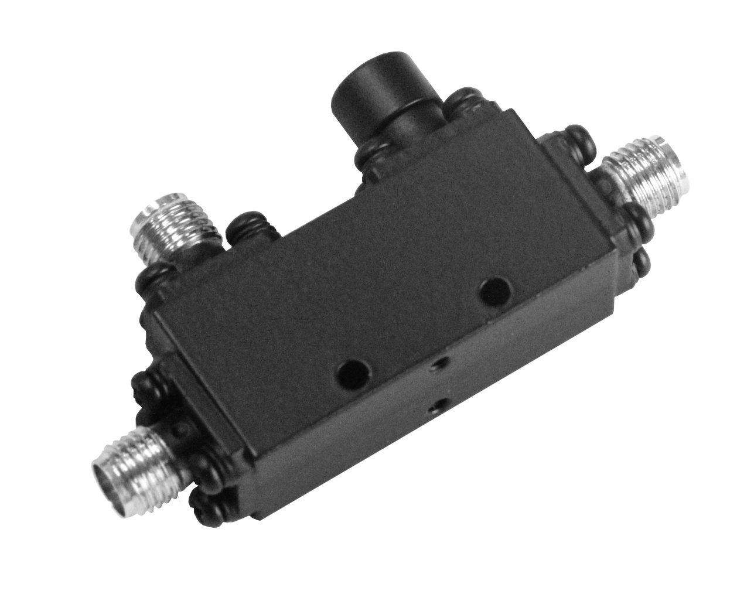
Couplers
Directional Couplers: up to 110GHz
90 Degree Hybrid Couplers: up to 40GHz
180 Degree Hybrid Couplers: up to 40GHz
Waveguide Directional Couplers
Couplers

Slide 22
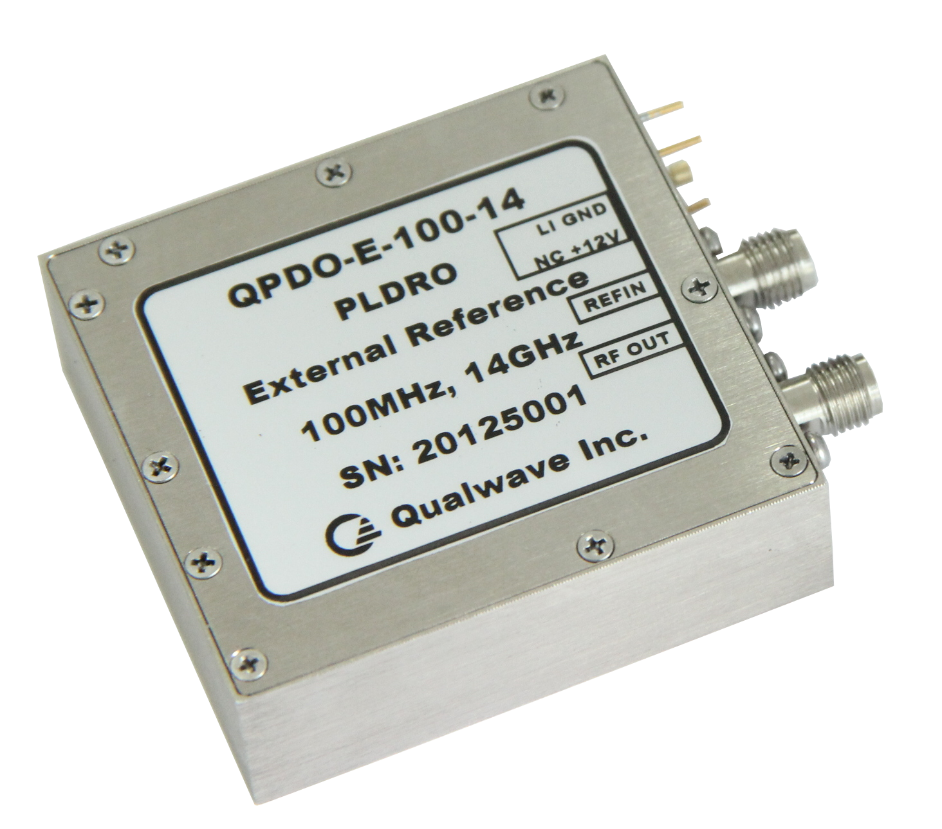
Frequency Sources
Freq.: 100MHz~40GHz
Reference: External/Internal
Power: 10dBm or higher
Phase Noise: -110dBc/Hz typical @1KHz Offset
Customization is available
No MOQ
Frequency Sources
Frequency Sources
Frequency Sources
DRO
DRO
DRO
VCO
VCO
PLXO
PLDRO
PLXO
PLDRO
PLDRO
PLVCO

Slide 23
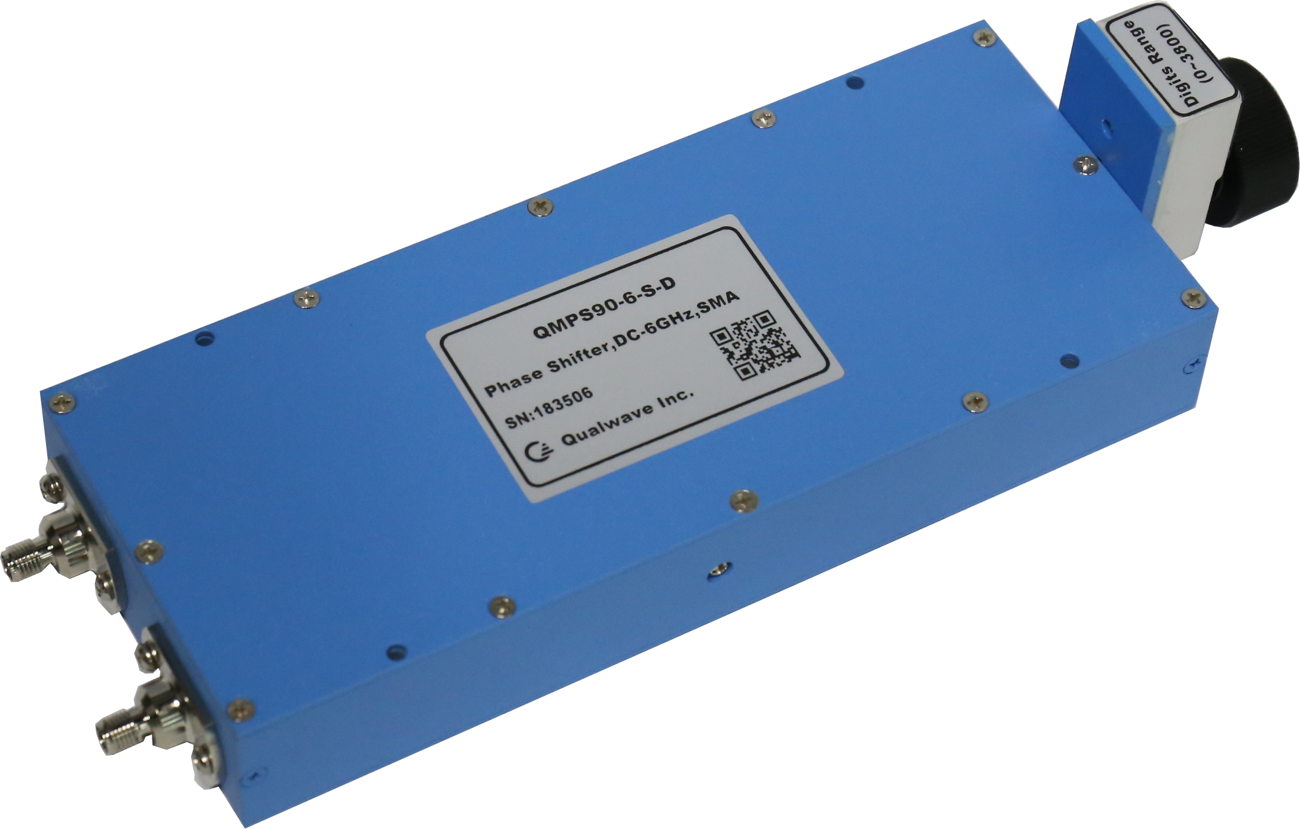
Phase Shifters
Manual Phase Shifters:
Up to 40GHz | Up to 900°/GHz | Up to 100W
Digitally Controlled Phase Shifter:
Up to 40GHz
Voltage Controlled Phase Shifter:
Up to 40GHz
Phase Shifters
Manual Phase Shifters
Digital Phase Shifters
Voltage Controlled Phase Shifters

Slide 24
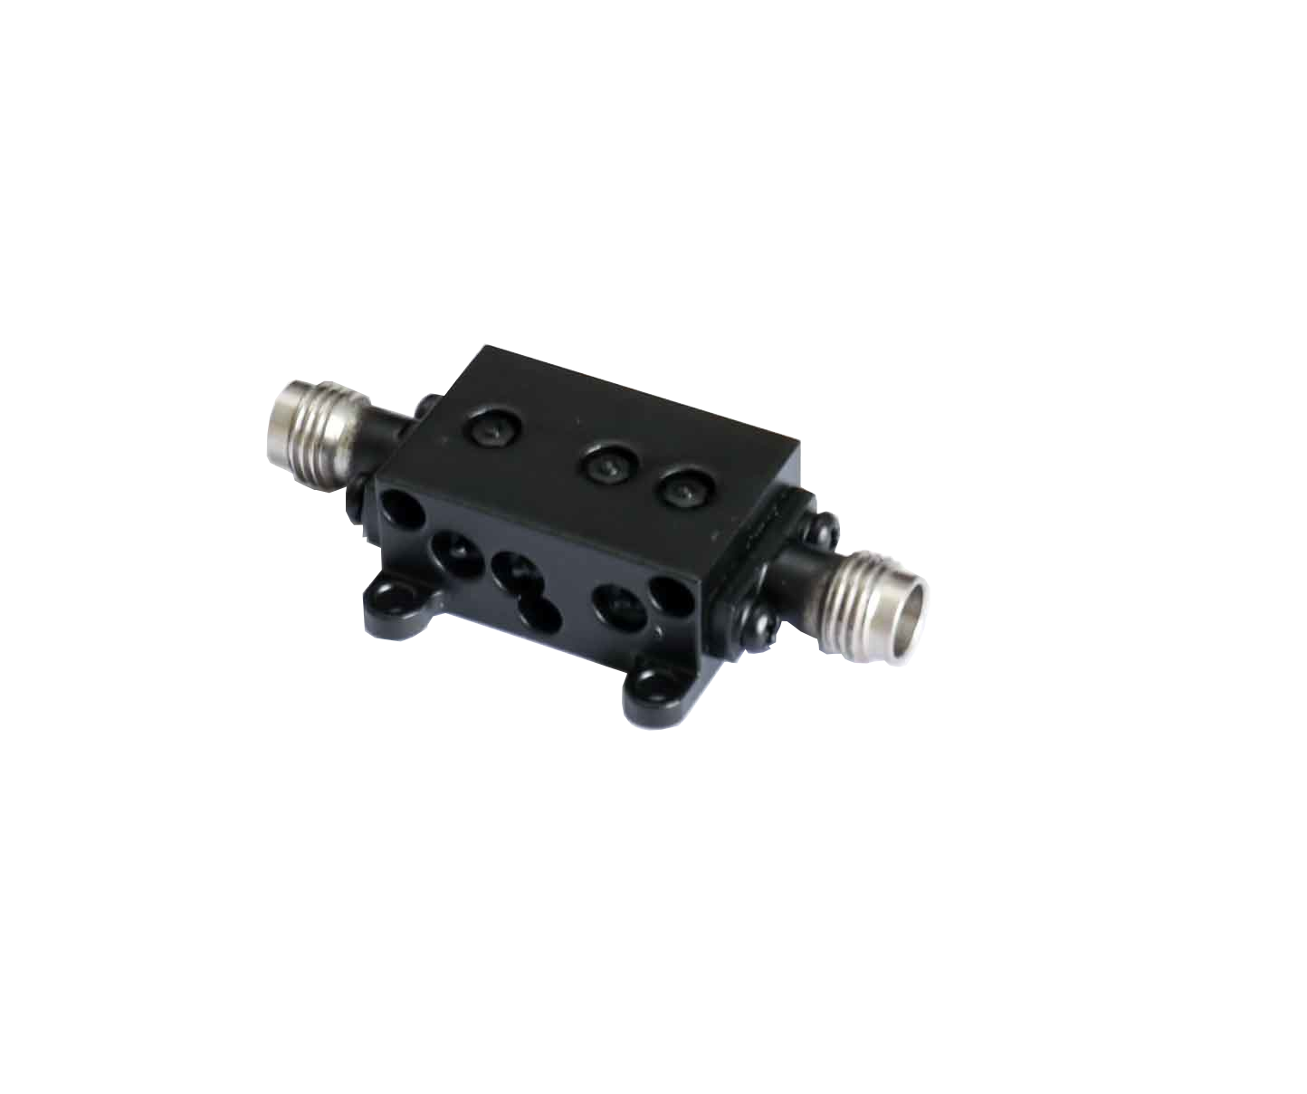
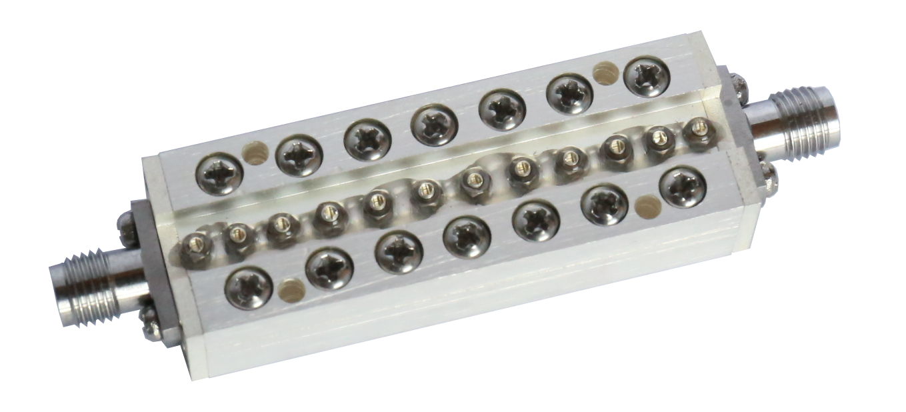
Filter
Freq.: Up to 110GHz
Stopband Attenuation: up to 90dB
Customization is available
Coaxial Filter
Band Pass
Band Pass
High Pass
High Pass
Low Pass
Band Reject

Slide 25
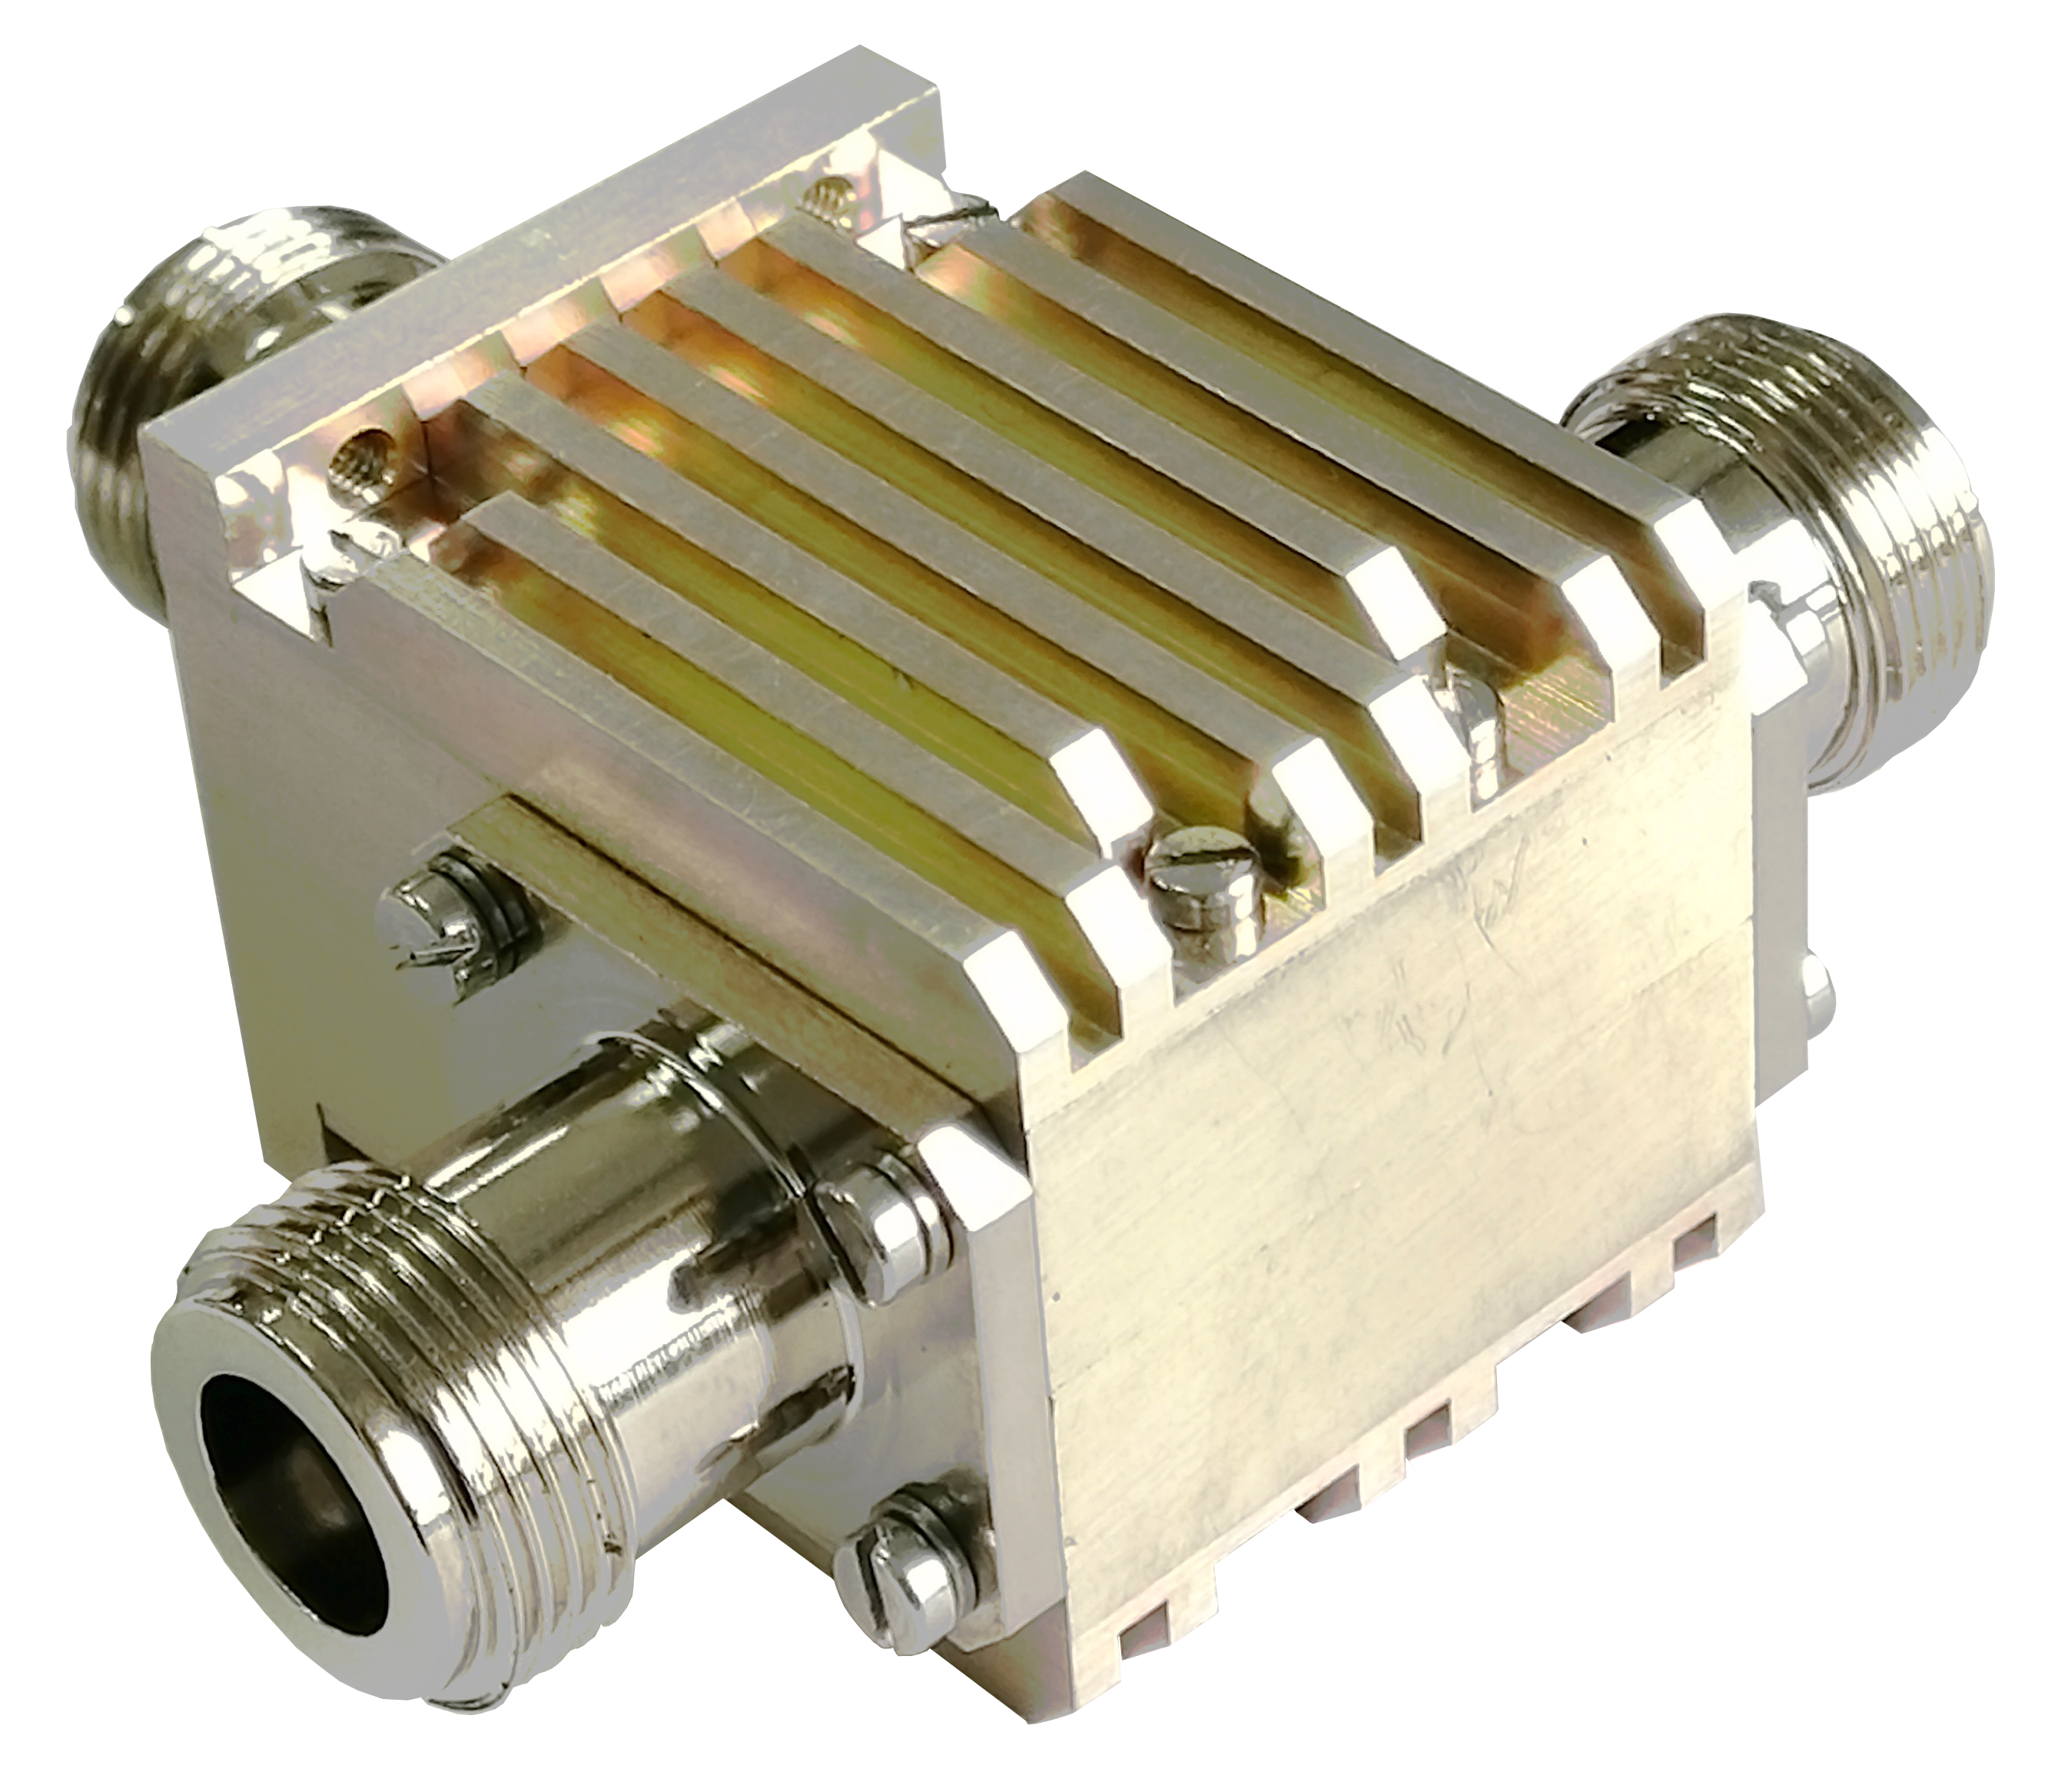
Circulators/Isolators
Freq.: 10MHz ~110GHz
Isolation: 16 ~ 50dB
Bandwidth: up to 4 Octaves
Insertion Loss: 0.3 ~ 1dB typical
Average Power: up to 1.5KW CW
Customization is available
Frequency Sources
Frequency Sources
Circulators/
Isolators
Coaxial
Drop-In
Surface Mount
Waveguide
Microstrip

Slide 26
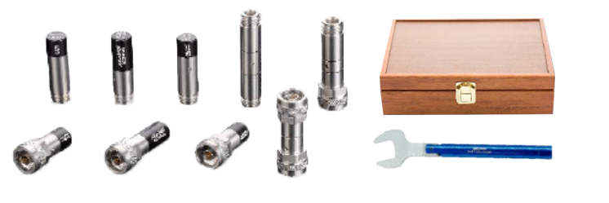
Calibration Kits
Freq.: Up to 67GHz
VSWR: ≤1.15 @40GHz,1.06@26.5GHz
Connectors
7
mm
1.85
mm
2.4
mm
2.92
mm
3.5
mm
L16
N

Slide 27
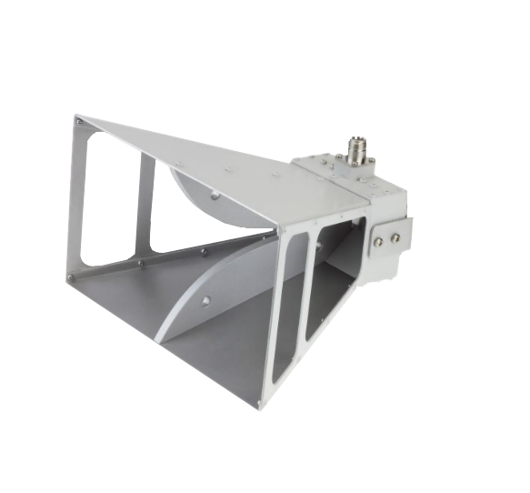
Antennas
Freq.: Up to 116GHz
Customization is available
Antennas
Rectangular Horn Antennas
Double Ridged Horn Antenn
Conical Horn Antennas

Slide 28
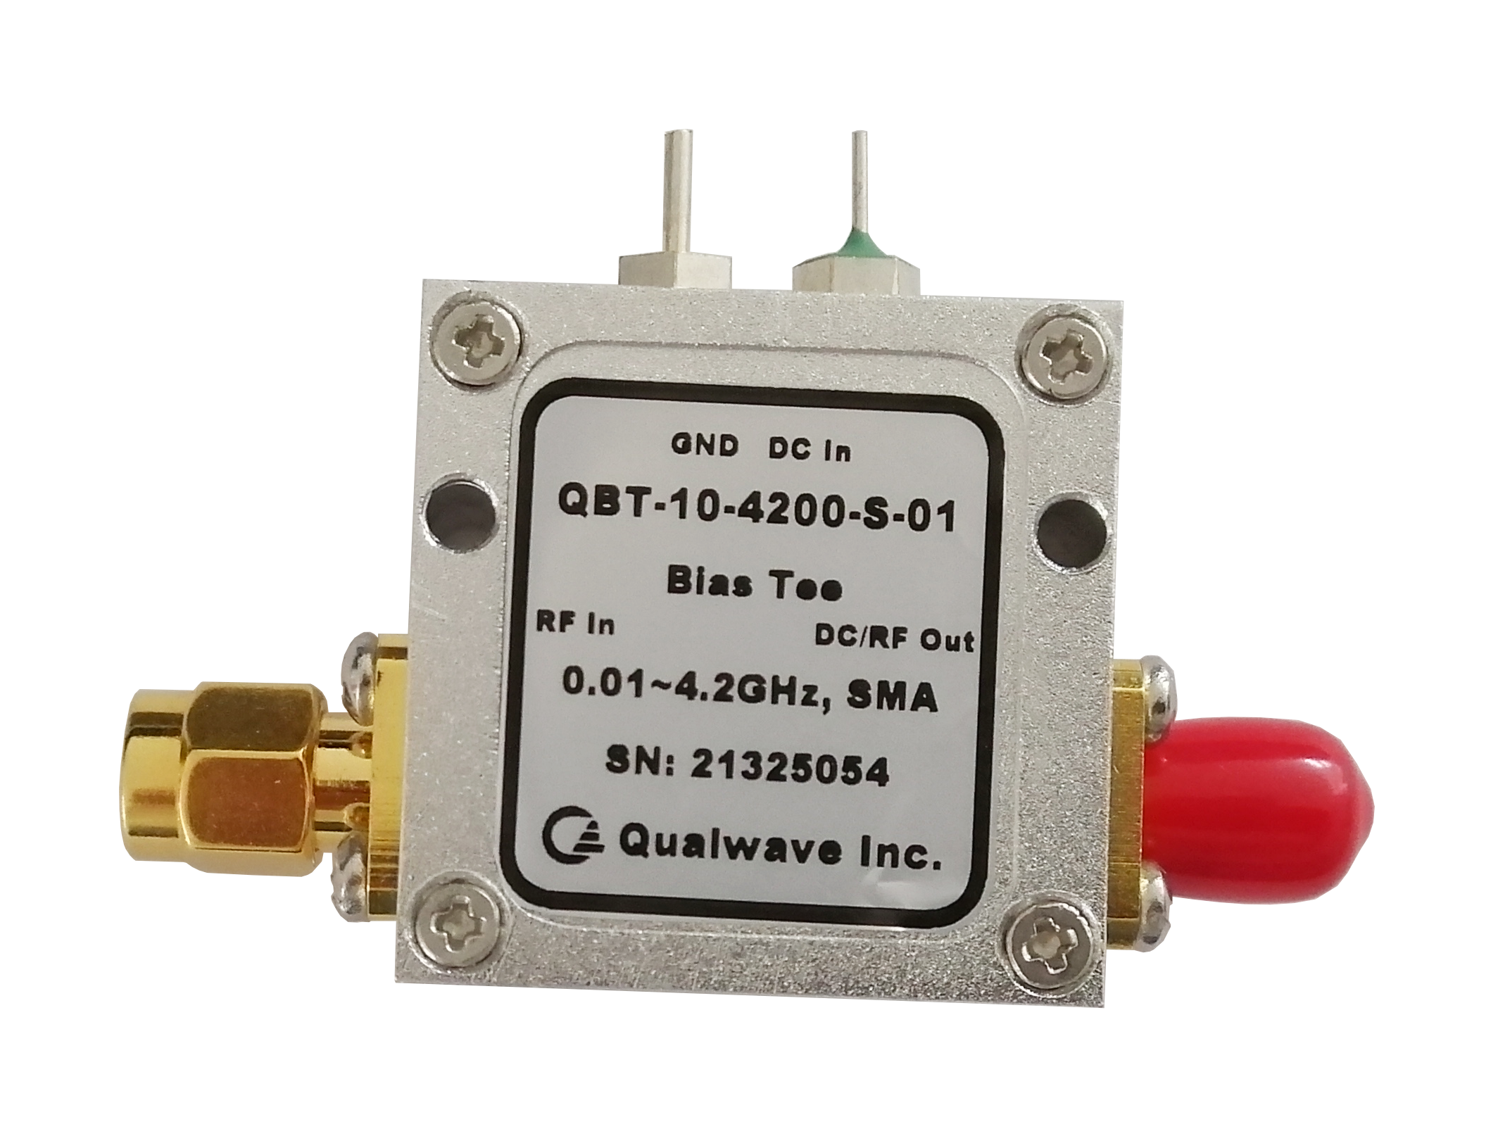
Other Products
Bias Tee: 0.005~40GHz
Frequency Multipliers: up to 110GHz
Frequency Dividers: up to 110GHz
Equalizer: up to 40GHz
* Customization is available
Other Products

Slide 29
Contact us
5F, Bld.1, Tianke Plaza,
No.999 Tiangong Ave., Tianfu New Area, Chengdu, 610015, China
ADDRESS
PHONE
+86-28-6115-4929
E-MAIL
sales@qualwave.com
WEB
www.qualwave.com

